Slide 1

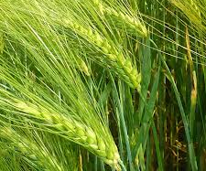


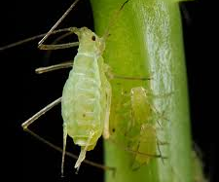
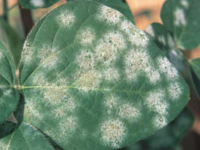
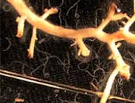
Bioinformatics for Research
www.bioinfo.wsu.edu/teaching
Gigabytes of NGS data
?
ATCGTAGGCTAGCCTATG
?
Publishable results
Next-gen sequencing data getting you down?
Does it seem like the analysis programs are in a mystical language?
Don’t know what the results really mean?
THIS CLASS IS FOR YOU!!!
Learn about:
Basic nucleotide and protein alignments
Introductory Unix/Linux and perl basics
How to use Unix/Linux and web-based BLAST
Genome assembly
Annotation of genomes
RNA-Seq analysis (CLC/Trinity)
GBS analysis (STACKs/Tassel)
Submitting data to NCBI Genbank
Spring 2017--HORT 550, 4 credits
Lecture: Tu, Th 1200-1315 Lab: F 1310-1600
Students must have a laptop for class
Questions? Contact Dorrie Main, dorrie@wsu.edu

